Slide 1
And on the Seventh Day, He Rested.
“De Sanctificiatione septime diei”
Creation map from the Nuremberg Chronicle (1493), Latin Version
Lorraine Sherry, Secretary, Rocky Mountain Map Society

Slide 2
Some history.
Mid 1400s: Nuremberg – northern center of commerce, crafts, politics, and Renaissance humanism
1455: Printing Press invented, Gutenberg Bible printed in Maintz
1492: Fall of Granada, Columbus discovers the New World
1491: Patents granted for Nuremberg Chronicle, Volgemut gets contract for woodcut illustrations
1491: Hartmann Schedel writes Latin text for chronicle, describing 7 ages of world history
1493: Latin and English Versions printed and distributed by Anton Koberger

Slide 3
God RESTING in heaven Nine ranks of angels Earth-centered Universe
THESE MULTIPLE FIGURES ARE THE HEAVENLY HOSTS OF ANGELS, ALTHOUGH THEY LOOK LIKE PEOPLE.

Slide 4
Seraphim & Cherubim Thrones, Dominations, Principalities Powers & Virtues Archangels & Angels
HIGH RANK ANGELS (PINK CAPS OR GOLD CROWNS)
“NEARER MY GOD TO THEE...”
LOW RANK ANGELS (IN BLUE)

Slide 5
Earth Ring of Water ring of Air ring of Fire
FOUR MEDIEVAL ELEMENTS: EARTH, WATER, AIR, AND FIRE ARE AT THE CENTER OF THE UNIVERSE

Slide 6
JUPITER MARS vENUS
THE MIXED-UP ARISTOTELIAN SOLAR SYSTEM
THE SUN
THE MOON
MERCURY
SATURN

Slide 7
“FIRMAMENT” [FIXED STARS & ZODIAC] “CRYSTAL SPHERE” [WATERS ABOVE THE FIRMAMENT] “PRIMUM MOBILE” [IT MOVES EVERYTHING]
STILL THE LATE MEDIEVAL VIEW OF OUTER SPACE
GOLDEN GATES [WALLS ENCLOSING HEAVEN]

Slide 8
SUBSOLANUS [EAST WIND] APARCTIAS [NORTH WIND]
AUSTER [SOUTH WIND]
ZEPHYRUS [WEST WIND]

Slide 9
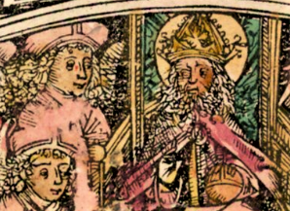
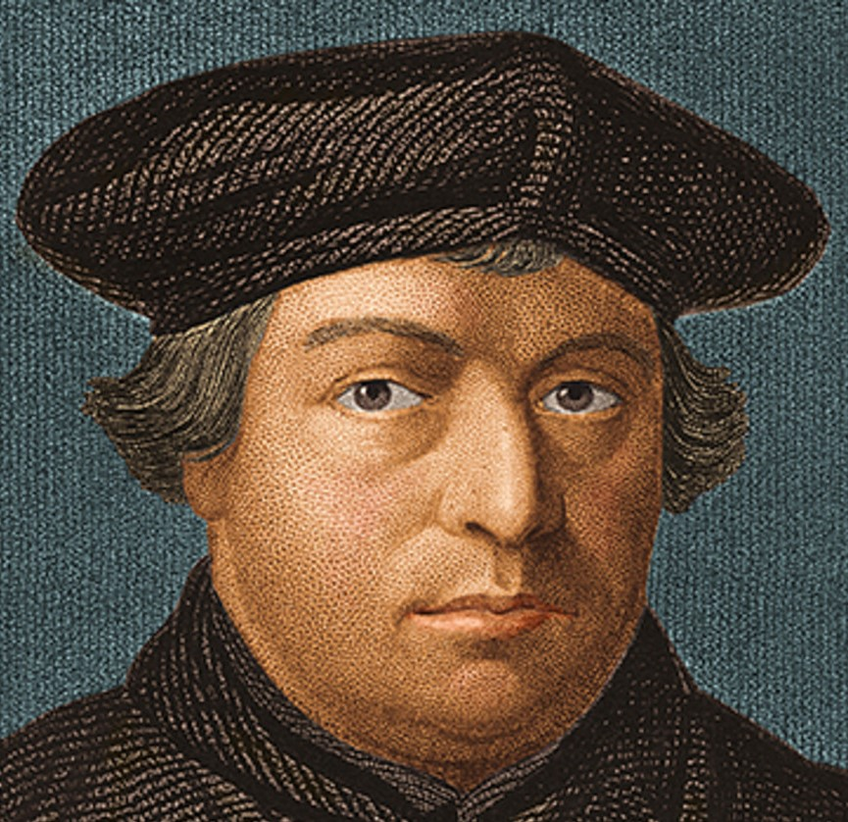
CHECK OUT THE HEAD- GEAR: Seraph versus Martin Luther!
THAT’S ALL FOLKS!

